Slide 1
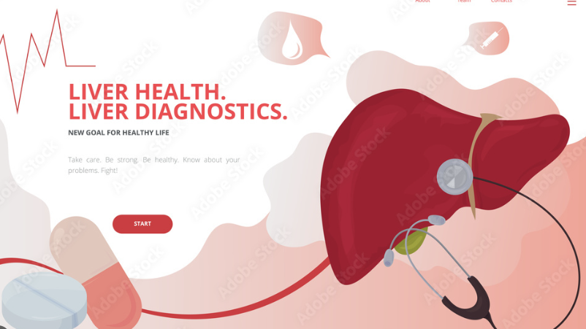
Guardians of Liver Health: A Classifier Quest to Predict and Prevent Indian Liver Disease
Submitted By:
Abhishek Singhal
U01433883

Slide 2

Unveiling the Purpose and Objectives
Model Development: Create a robust predictive model that accurately assesses the risk of liver diseases in individuals based on a diverse set of attributes.
Dataset Analysis: Analyze a representative dataset from the Indian population, considering demographic, lifestyle, and clinical data to enhance the model's accuracy and applicability.
Interpretability and Transparency: Prioritize the development of a model that is not only accurate but also interpretable, enabling healthcare professionals to understand and trust its predictions.
Contribution to Public Health: Contribute valuable insights to the field of preventive healthcare in India by providing a tool that can aid in early identification and intervention for liver diseases.

Slide 3
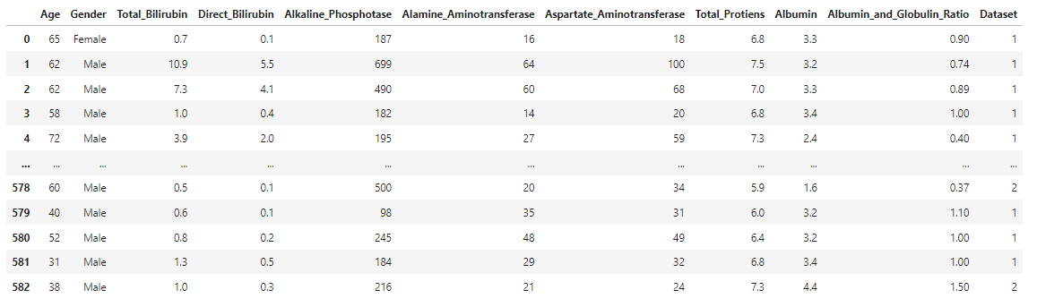
Here's a breakdown of the columns: Age : Represents the age of the patient. Gender : Indicates the gender of the patient (male or female). Total Bilirubin: Bilirubin is a yellowish substance found in bile. This column likely represents the total amount of bilirubin in the patient's blood. Direct Bilirubin: This is a subset of total bilirubin and represents the direct bilirubin in the patient's blood. Direct bilirubin is a measure of bilirubin that is not bound to albumin. Alkaline Phosphotase: Alkaline phosphatase is an enzyme found in the liver and other tissues. Elevated levels may indicate liver or bone issues. Alamine Aminotransferase: Also known as ALT or SGPT, this enzyme is found in the liver. Elevated levels may indicate liver damage or disease. Aspartate Aminotransferase: Also known as AST or SGOT, this enzyme is found in the liver and other organs. Elevated levels may indicate liver or heart issues. Total Proteins: Represents the total amount of proteins in the patient's blood. Albumin: Albumin is a type of protein produced by the liver. It plays a role in maintaining blood volume and pressure. Albumin and Globulin Ratio: The ratio of albumin to globulin in the blood. Abnormalities in this ratio can provide insights into liver and kidney function. Dataset: This is the target variable or the label for classification task. It indicates whether the patient has liver disease or not. It's a binary field, with values like 1 or 2 (or potentially labeled as “red" and “green").

Slide 4
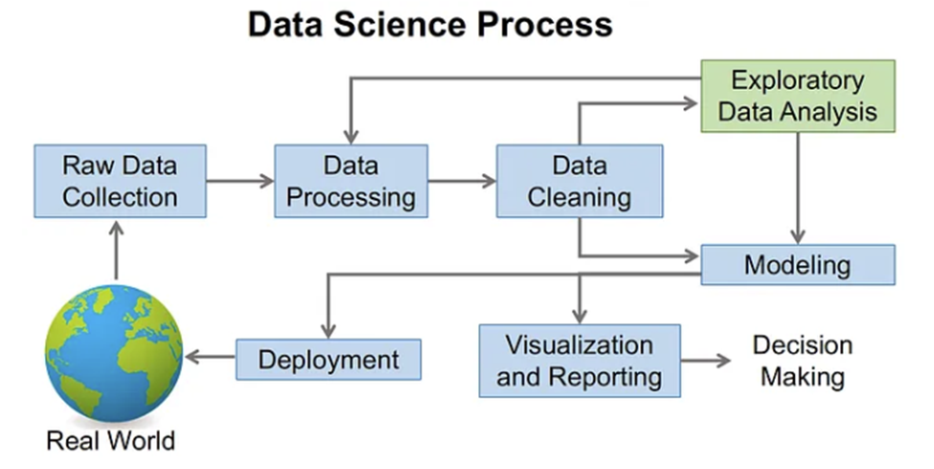
Data Processing

Slide 5
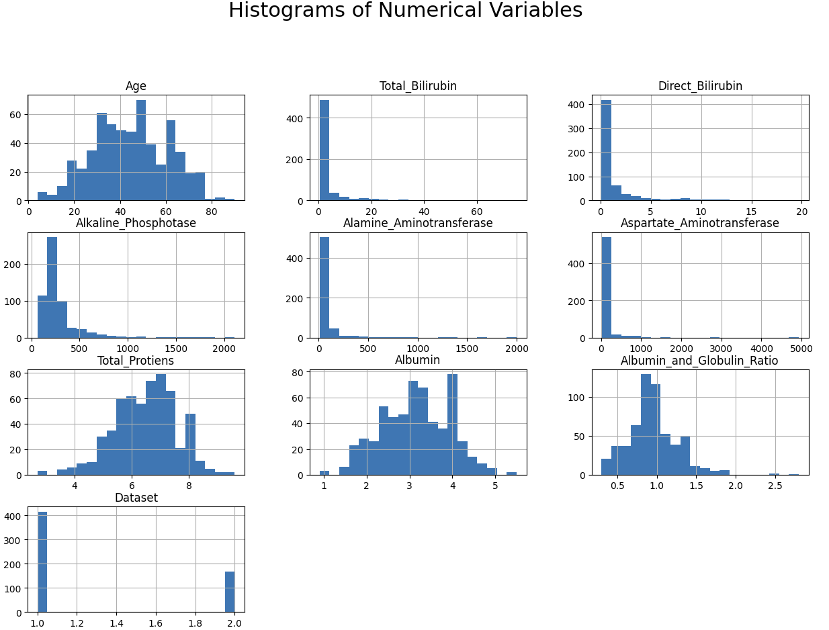
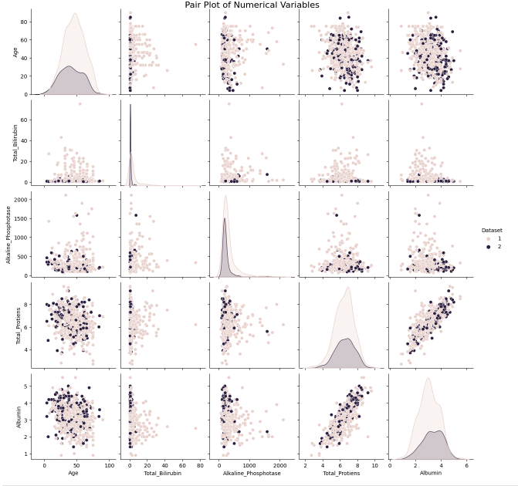
Data Analysis

Slide 6
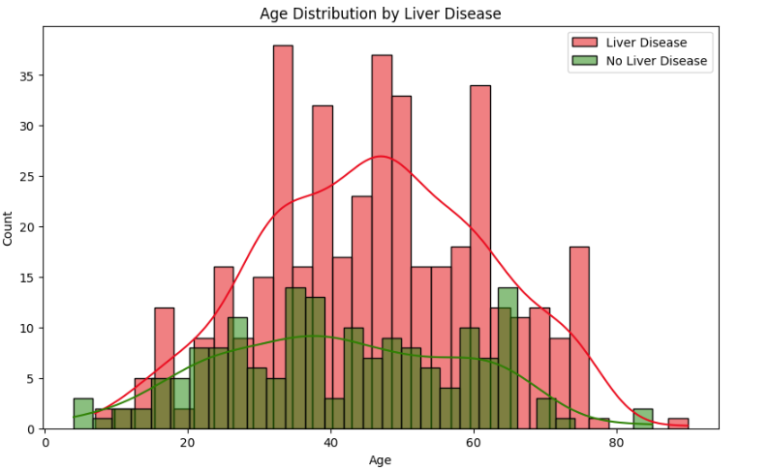
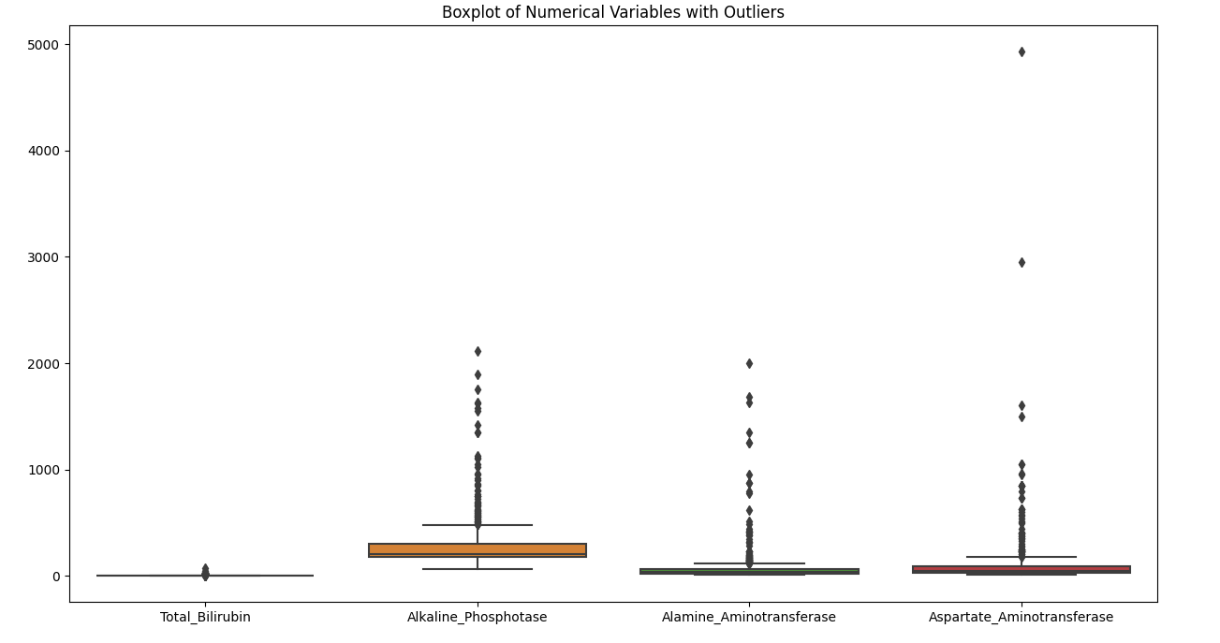
Data Analysis

Slide 7
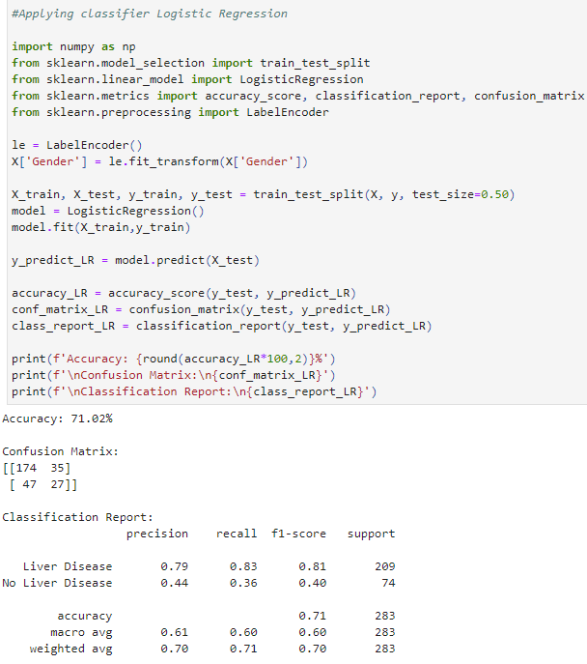
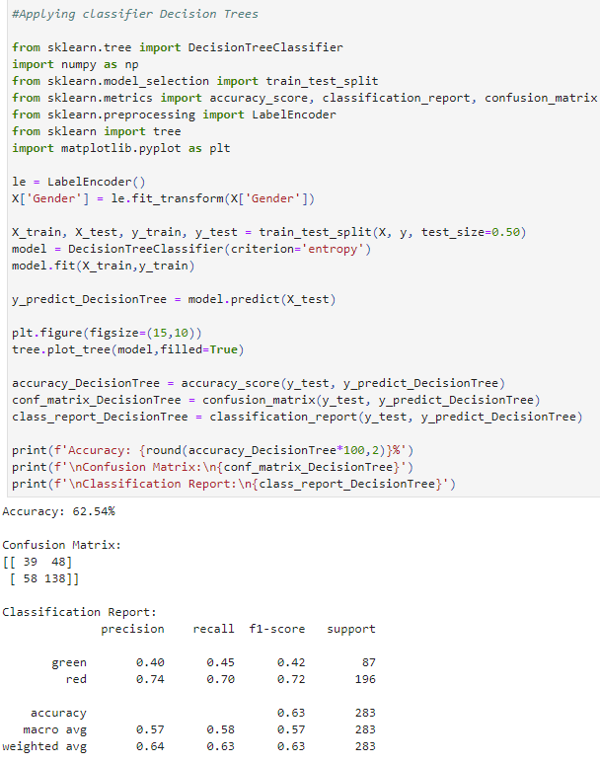
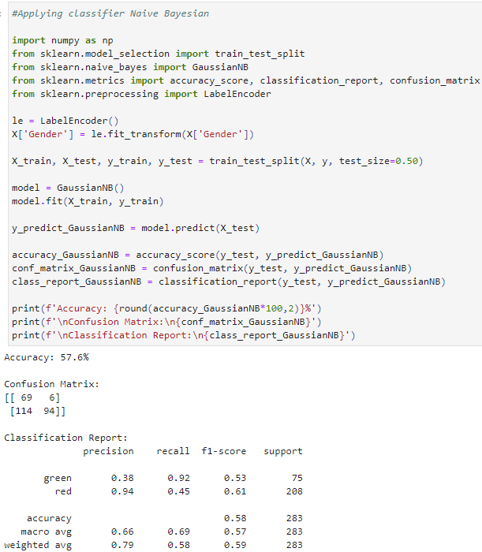
A Quest Through Diverse Classifiers in Machine Learning

Slide 8
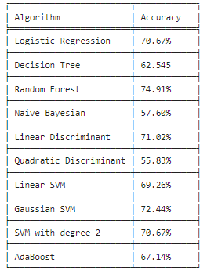

A Comparative Analysis of Accuracy Across Classifiers
Random Forest emerges as the top-performing classifier, showcasing superior accuracy and robust predictive capabilities in our analysis

Slide 9

Thank You

